Slide 1
CS665 : Introduction to Database systems
Project group 13:
Title:
Employee-Resource-Management System
Sai Sri Raj Nallam (U687F297)
Bala Hari Vishnu Tommandru ( T766R559 )
Ganji Vani ( Q957Z927 )

Slide 2
About Database
This is an Employee Resource Management System.
It is lightweight GUI system software application designed for management of employees and their work in an organization.
Here an organization HR or practitioner can see the names of employees and their working departments
He/she can access the details of employees and their departments and also have access to delete any employee records.

Slide 3
-continue
This database Model is a management tool that helps organisation to create employee profiles and departments and assign them to respective departments .
We can update the employee information and their departments.
we have used 4 tables to handle this system

Slide 4
Technologies used:
Programming language: Python
UI software : Python - Tkinter module
Database : MySQL
Repository : GitHub

Slide 5
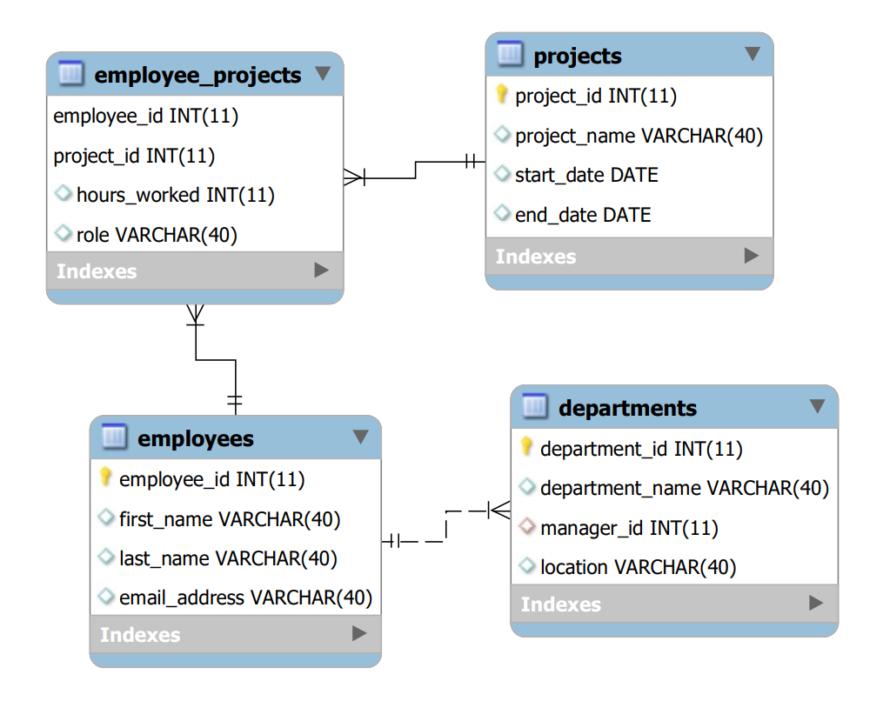
ER diagram for Employee Resource Management system
One-to-Many relationship between Employees and Employee_Projects tables
One-to-Many relationship between Projects and Employee_Projects tables:
Many-to-One relationship between Employees and Departments tables:
One-to-One or Many-to-One relationship between Employees and Departments tables:

Slide 6
Team Members Contribution:
Team members name (wsu id) | Contribution (%) and work accomplishments
Sai Sri Raj Nallam (U687F297) | (33.33%) DB creation using MySQL. Front end GUI design and operations of predefined SQL queries (Subqueries) in Database application Front end GUI design and operation for Inserting data,display of Tables of the database application
Bala Hari Vishnu Tommandru (T766R559 ) | (33.33%) Creation of repository in Github Front end GUI design for CRUD operations in Database application,Subqueries Time to Time Verification and validation of all the operations (both front end and DB)
Ganji Vani ( Q957Z927 ) | (33.33%) Concept and Idea for database design of project Overall layout and design of GUI front end Integration of different modules and their operations for GUI application.
.

Slide 7
Thank you

